Slide 1

ISP550 INFORMATION SYSTEMS ENGINEERING
Topic 2: The Origins of Software
MARCH2026 – AUGUST2026

Slide 2
Learning Objectives
2.1 Explain outsourcing
2.2 Describe six different sources of software
2.3 Discuss how to evaluate off-the-shelf software
2.4 Explain reuse and its role in software development

Slide 3
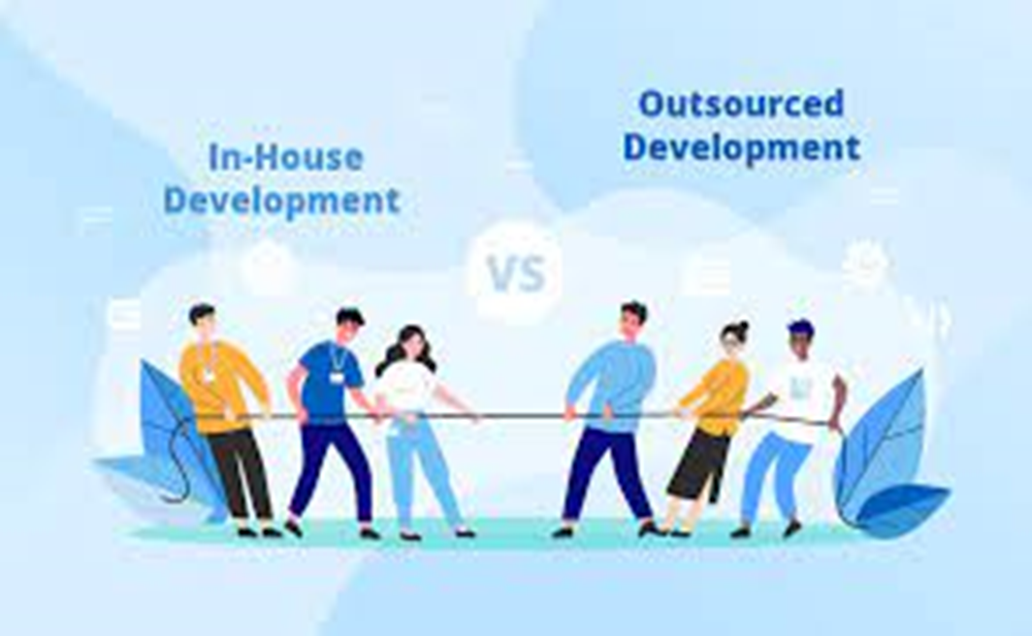
Introduction
In the past software development for organizations was done mostly in-house and from scratch
Today, there are many different sources of software
Now focus is on where you can obtain the many pieces and components that you will combine into an application that you have been asked to create

Slide 4
Outsourcing
Outsourcing – turning over responsibilities for some or all of an organization’s information systems applications and operations to an outside firm
Reasons for outsourcing:
Freeing up internal resources
Increasing the revenue potential of the organization
Reducing time to markets
Increasing process efficiencies
Outsourcing noncore activities

Slide 5
Sources of Software
Sources of software can be categorized into six major groups:
Information technology services firms
Packaged software producers
Enterprise solutions software
Cloud computing
Open-source software
In-house development

Slide 6
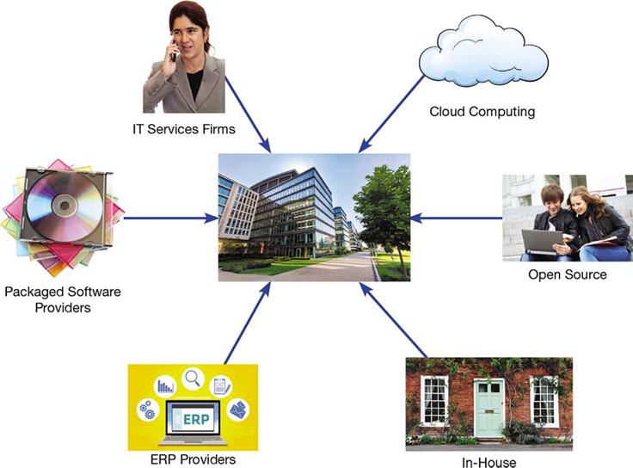
Figure 2-1: Sources of Application Software
(Sources: Middle: Pixachi/Shutterstock, Clockwise starting with upper left:Kamira/Shutterstock; Amit John / Pearson India Education Services Pvt. Ltd; 1000 Words/Shutterstock; Aa Amie/Shutterstock; grgroup/Fotolia; Le Do / Shutterstock)

Slide 7
Information Technology Service Firms
I T service firms help companies develop customer information systems for internal use
These firms employ skilled I T people
Some examples of these companies are seen in the table on the next slide

Slide 8
Table 2-1: Leading Software Firms and Their Development Specializations
Specialization | Example Firms or Websites
I T Services | Accenture Computer Sciences Corporation (C S C) I B M H P E
Packaged Software Providers | Intuit Microsoft Oracle S A P A G Symantec
Enterprise Software Solutions | Oracle S A P A G
Cloud Computing | Amazon.com Google I B M Microsoft Salesforce.com
Open Solution | SourceForge.net

Slide 9
Package Software Producers
Serve many market segments
Prepackaged software is off-the-shelf and is not customizable
Examples include Quicken, QuickBooks, Microsoft Word, TurboTax
Meets 70% of an organization’s needs
An example of Microsoft Word is on the next slide

Slide 10
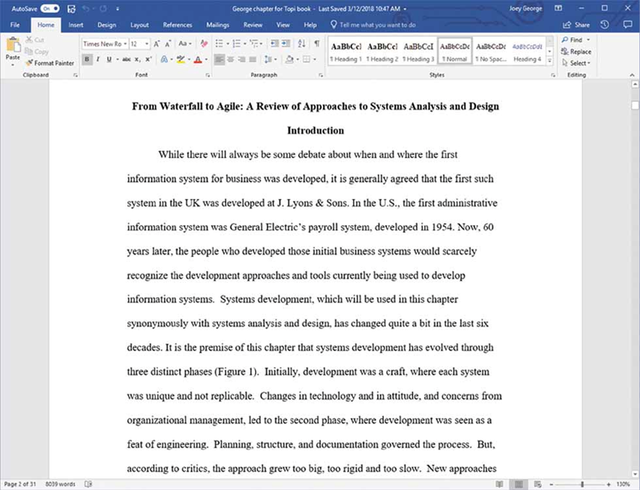
Figure 2-2: Document Created in Microsoft Word
(Source: Microsoft Corporation)

Slide 11
Enterprise Solutions Software
Enterprise resource planning (E R P) systems integrate individual traditional business functions into a series of modules so that a single transaction occurs seamlessly within a single information system rather than several separate systems
Benefits include:
A single repository resulting in more consistent and accurate data
Less maintenance
S A P A G is the leading vendor of E R P systems

Slide 12
Cloud Computing (1 of 2)
Cloud computing – the provision of computing resources, including applications, over the Internet, so customers do not have to invest in the computing infrastructure needed to run and maintain the resources
Users pay on a per-use system or license the software
Global market, based on cloud computing, is estimated at $209.2 billion and estimated to grow to $383.3 billion by 2020

Slide 13
Cloud Computing (2 of 2)
Cloud computing examples include:
Google docs, Sheets, and Slides
Share, create docs, spreadsheets, presentations
SalesForce.com (Customer relationship management)
Allows software as a service (S a a S)
Benefits include:
Freeing internal staff
Faster access to applications
Lower-cost to corporate-quality applications
Concerns include security and reliability

Slide 14

Figure 2-3: Presentation Edited in Google Slides
(Source: Reprinted by permission from Joey F. George)

Slide 15
Open-Source Software
Freely available, including source code
Developed by a community of interested people
Performs the same functions as commercial software
Examples: Linux, my S Q L, Firefox
Two ways to make money with open-source software:
Provide maintenance and services
Sell a more full-featured version of the free software

Slide 16
In-House Development
Involves using an organization’s staff to create systems
Can lead to more maintenance needs
Not unusual to incorporate a hybrid of in-house and purchased components as seen in the table on the next slide

Slide 17
Table 2-2: Comparison of Six Different Sources of Software Components
Producers | When to Go to This Type of Organization for Software | Internal Staffing Requirements
I T services firms | When task requires customer support and system can’t be build internally or system needs to be sourced | Internal staff may be needed depending on application
Packaged software producers | When supported task is generic | Some IS and user staff to define requirements and evaluate packages
Enterprise-wide solutions vendors | For complete systems that cross functional boundaries | Some internal staff necessary but mostly need consultants
Cloud computing | For instant access to an application; when supported task is generic | Few; frees up staff for other I T work
Open-source software | When supported task is generic but cost is an issue | Some I S and user staff to define requirements and evaluate packages
In-house developers | When resources and staff are available, and system must be built from scratch | Internal staff necessary though staff size may vary

Slide 18
Choosing Off-the-Shelf Software (1 of 2)
Criteria to consider when choosing off-the shelf software:
Cost (compare developing in-house versus. purchasing or licensing the software package)
Functionality (the tasks that the software can perform and the mandatory, essential, and desired system features)
Vendor Support (can vendor provide support and how much it can provide)
Flexibility (the ease with which software is customized)
Documentation (understandable and up-to-date user’s manual and technical documentation)

Slide 19
Validating Purchased Software Information
Request for Proposal (R F P) – document provided to vendors asking them to propose hardware and system software that will meet the requirements of a new system
If soliciting R F Ps from more than one vendor be sure to:
Create a scoring value for each item requested
Calculate a total score for each vendor after R F Ps are received
Select a vendor with a high score

Slide 20
Reuse (1 of 2)
Reuse – the use of previously written software resources, especially objects and components, in new applications
Reuse is commonly applied to two different development technologies:
Object-oriented development
Object class encapsulates data and behavior of common organizational entities (e.g. employees)
Component-based development
Components can be as small as objects or as large as pieces of software that handle single business functions

Slide 21
Reuse (2 of 2)
Reuse has become a standard part of corporate development
Factors relating to successful reuse include:
Knowledge of the domain in which reuse is to occur
Customer support
Commitment and understanding of senior management
Sound organizational processes
Skilled and experienced developers

Slide 22
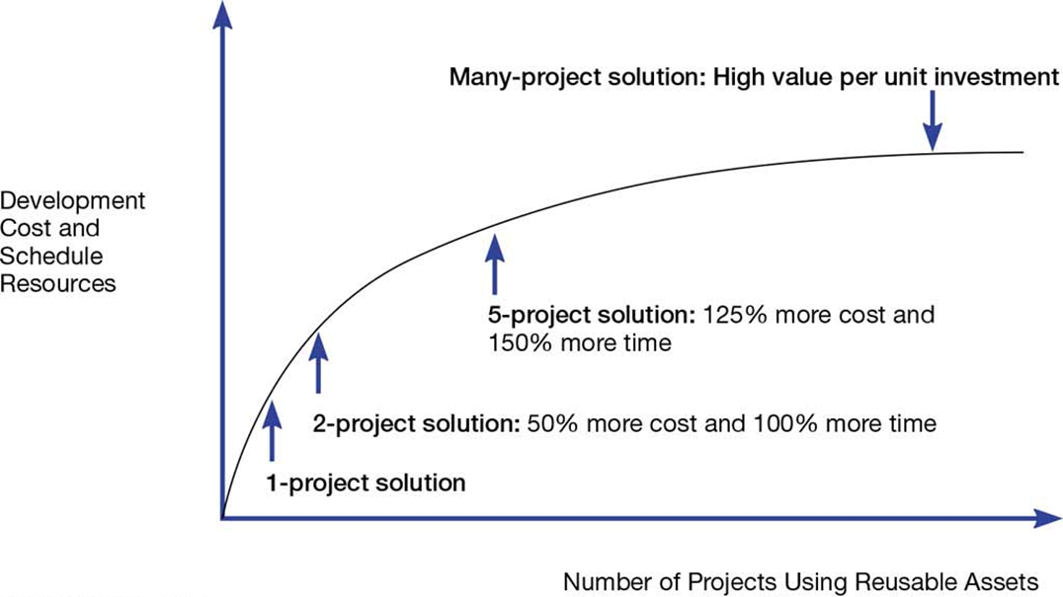
Figure 2-4: Investments Necessary to Achieve Reusable Components
(Source: Royce, Walker, Software Project Management: A Unified Framework, 1st ed., ©1998. Reprinted and Electronically reproduced by permission of Pearson Education, Inc. Upper Saddle River, New Jersey)

Slide 23
Three Basic Steps of Software Reuse
Abstraction
Involves design of reusable software
Storage
Making software assets available for others to use
Recontextualization
Making the software understandable to developers
Grinter, 2001

Slide 24
Approaches to Reuse
Ad-hoc – Individuals are free to find or develop reusable assets on their own
Facilitated – developers are encouraged to practice reuse
Managed – the development, sharing, and adoption of reusable assets is mandated
Designed – assets mandated for reuse as they are being designed for specific applications
Griss, 2003

Slide 25
Table 2-3: Four Approaches to Reuse
Approach | Reuse Level | Cost | Policies and Procedures
Ad hoc | None to low | Low | None
Facilitated | Low | Low | Developers are encouraged to reuse but are not required to do so
Managed | Moderate | Moderate | Developers, sharing, and adoption of reusable assets are mandated; organizational policies are established for documentation, packaging, and certification
Designed | High | High | Reuse is mandated; policies are put into place so that reuse effectiveness can be measured; code must be designed for reuse during initial development, regardless of the application it is originally designed for; there may be a corporate office for reuse
(Source: Based on Griss, 2003.)

Slide 26
Summary
In this chapter you learned how to:
Explain outsourcing
Describe six different sources of software
Discuss how to evaluate off-the-shelf software
Explain reuse and its role in software development

